Slide 1
POWERPOINT PRESENTATION
PROGRAMMING IN C

Slide 2
C LANGUAGE
C language is a procedural programming language . It is developed by Dennis Ritchie in 1972. It works on top to down approach. It was mainly developed as a system programming language to write operating system. The main features of C language include low-level access to memory, simple set of keywords, and clean style, these features make C language suitable for system programming like operating system or compiler development.

Slide 3
PROGRAM DEVELOPMENT LIFE CYCLE
PDLC(Program Development life cycle):-
Program Development life Cycle & Software Development Life Cycle. The programming development cycle is a process of steps, used by programmers to more efficiently manage their time in designing error-free programs that produce the desired output.
STEPS OF PDLC:- There are seven steps of pdlc are following as:
Problem Definition.
Problem Design.
Algorithm Development & flow chart.
Program Coding .
Compilation & Debugging.
Program testing.
Implementation and documentation.

Slide 4
PROBLEM
DEFINITION
PROGRAM
DESIGNING
ALGORITHM AND
FLOWCHART
PROGRAM
CODING
DEBUGGING
AND COMPILATION
IMPLIMENTATION
AND
DOCUMENTATION
PROGRAM
TESTING

Slide 5
1. Problem Definition :-
In this phase, we define the problem statement and we decide the boundaries of the problem. In this phase we need to understand the problem statement, what is our requirement, what should be the output of the problem solution. These are defined in this first phase of the program development life cycle.
2. Program Design :-
Language (or PDL, for short) is a method for designing and documenting methods and procedures in software.

Slide 6
3. Algorithm Development and Flowchart:-
During this phase, we develop a step by step procedure to solve the problem using the specification given in the previous phase. That means we write the solution in step by step statements.
FOR EXAMPLE:-
// Write a algorithm for addition of two numbers.
Step 1: Start
Step 2: Declare variables num1, num2 and sum.
Step 3: Read values num1 and num2.
Step 4: Add num1 and num2 and assign the result to sum. Sum←num1+num2.
Step 5: Display sum Step 6: Stop

Slide 7
4.Program Coding :-
This phase uses a programming language to write or implement actual programming instructions for the steps defined in the previous phase. That means we write the program to solve the given problem using programming languages like C, C++, Java etc.
PROGRAM CODING FORMAT
#include<stdio.h>
#include<conio.h>
void main()
{
--------------- ;
--------------- ;
}

Slide 8
// WRITE A PROGRAM FOR ADDING TWO NUMBERS.
#include<stdio.h>
int main()
{
int a, b, c;
printf("Enter two numbers to add\n");
scanf("%d%d", &a, &b);
c = a + b;
printf("Sum of the numbers = %d\n", c);
return 0;
}

Slide 9
5.Debugging & Compiling:-
Debugging - The Bugs found above are the causes of some wrong code. So locating the wrong code by running the application with special tools (debugger) is called debugging.
Compiling- Compiling is a process of converting code into an executable (Application). This is applicable to compiled languages such as C, C++.
It helps to finding the errors present in the program coding. Its help in debugging process in removing
the errors.

Slide 10
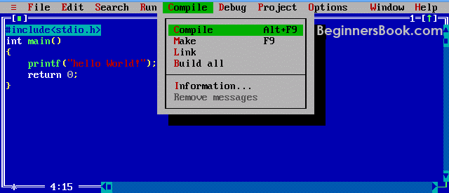
Figure:-Compilation

Slide 11
6.Testing:-
There are other testing types such as Unit testing, Integration testing, Stress testing etc. If there are problems encountered while testing, they are termed as Bugs.
7.Implementation and documentation:-
Implementation process can vary from organization to organization, dependent largely on the details of the actual strategic plan, but some basic steps can assist in the process and ensure that implementation is successful
Documentation is intended to allow another person, or the programmer at a later date, to understand the program. Internal documentation consists of statements in the program that are not executed, but point out the purposes of various parts of the program.

Slide 12
DIFFRENCE B/W PROGRAM DEBUGGING AND TESTING
PROGRAM TESTING | PROGRAM DEBUGGING
1. Testing always starts with known conditions, uses predefined methods, and has predictable outcomes too. | 1. Debugging starts from possibly un-known initial conditions and its end cannot be predicted, apart from statistically.
2. Testing can and should definitely be planned, designed, and scheduled. | 2. The procedures for, and period of, debugging cannot be so constrained.
3. It proves a programmers failure. | 3. It is the programmer’s vindication.
4. It is a demonstration of error or apparent correctness. | 4. It is always treated as a deductive process.
5. Testing purpose is to find bug. | 5. Debugging purpose is to find cause of bug.

